Slide 1
What's New in
Elastic Search
Version 9.3
Roberto Arico - Senior Solutions Architect

Slide 2









Workshop Agenda
Simplify
Optimize
Innovate with AI
ES|QL Readable Queries
LOOKUP JOIN One query
Workflows Automation
Inference Endpoint
Agent Builder Ask in English
ELSER Search by meaning
From multiple API calls to single-query efficiency
From complex external tools to native automation
From keyword matching to semantic understanding
Notes:
Simplify
Replace complex external orchestration with readable ES|QL and native Workflows
Optimize:
Reduce costs and latency using LOOKUP JOIN to keep data in-cluster
Innovate with AI:
Democratize investigation with Agent Builder and semantic understanding via ELSER

Slide 3



Today’s Core Philosophy
Search the insight.
Workflows on it.
Agent Builder it.
finds
acts
explains
Simplify:
ES|QL + Workflows
Optimize:
Automated Response
Innovate with AI:
Natural Language Investigation

Slide 4


Today’s Format
Presentation 5 min
Presentation & Live Demo.
Understanding the ‘Why’ and the ‘How’.
Workshop 10 min
Hands-on Challenges. Accessing the lab
Environment and running the code.
4 sections with 2 parts

Slide 5





The Challenge: Review Bomb
“Review Bombing” is a coordinated attack where bad actors flood a business with fake negative reviews to manipulate reputation
Restaurants:
Yelp, Google, TripAdviser
E-commerce:
Amazon, Walmart, Home Depot
Apps:
App Store, Google Play
B2B:
Salesforce, Microsoft
Erodes consumer trust one fake star at a time

Slide 6



The High Cost of Fake Reviews
5-9%
Review integrity is not just a data annoyance. It is a financial imperative. When trust erodes, revenue follows. Bad actors use coordinated attacks to manipulate perception across platforms from Amazon, to Google to the App Store
Revenue loss per 1-star drop
Platform Churn
Scale Challenge
Millions of reviews removed manually. Manual triage cannot keep pace with automated attacks.
Users abandon platforms when they encounter fake narratives.

Slide 7




Workshop Journey
1. Detection Logic
2. Workflow Def
3. AI Investigation
4. Simulation
Write ES|QL queries to identify patterns.
Define automation logic
Build an AI Agent with custom tools
Launch the live attack lifecycle
Correlates Review Content with User Trust Scores
Scheduled execution every 5 minutes orchestrates response
Natural Language analysis using custom AI tools
End-to-End Response
Notes:
Simplify
Replace complex external orchestration with readable ES|QL and native Workflows
Optimize:
Reduce costs and latency using LOOKUP JOIN to keep data in-cluster
Innovate with AI:
Democratize investigation with Agent Builder and semantic understanding via ELSER

Slide 8
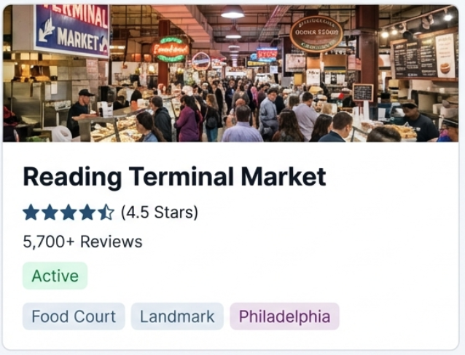
Know Your Data
Using Yelp Dataset (Philadelphia Subset)
Defend this beloved business!!
Scope:
100 Businesses
~76K Users
~149k Reviews
Indices:
businesses, users, reviews, incidents, notifications
Trust Score Logic:
Low trust (<0.3): New/Inactive accounts
High trust (>0.7): Established contributors
Notes:
Simplify
Replace complex external orchestration with readable ES|QL and native Workflows
Optimize:
Reduce costs and latency using LOOKUP JOIN to keep data in-cluster
Innovate with AI:
Democratize investigation with Agent Builder and semantic understanding via ELSER

Slide 9
Let’s Get Hands-On
Time to Simplify, Optimize and Innovate with AI
Log into your workshop environment
https://ela.st/za-community-mar2026
available for 48 hours
Mission:
Detect a Review Bomb
Contain it automatically
Generate an incident report
Search finds. Workflows acts. Agent Builder explains

Slide 10
Challenge 1: Know your data
Activities:
Getting to Know your data
Background
Data Model
Explore it
Understand Trust scores
Review Patterns
Semantic Search
Enrichment with LOOKUP JOIN
1. Detection Logic
Write ES|QL + LOOKUP JOIN to identify patterns.
Correlates Review Content with User Trust Scores
Notes:
Simplify
Replace complex external orchestration with readable ES|QL and native Workflows
Optimize:
Reduce costs and latency using LOOKUP JOIN to keep data in-cluster
Innovate with AI:
Democratize investigation with Agent Builder and semantic understanding via ELSER

Slide 11
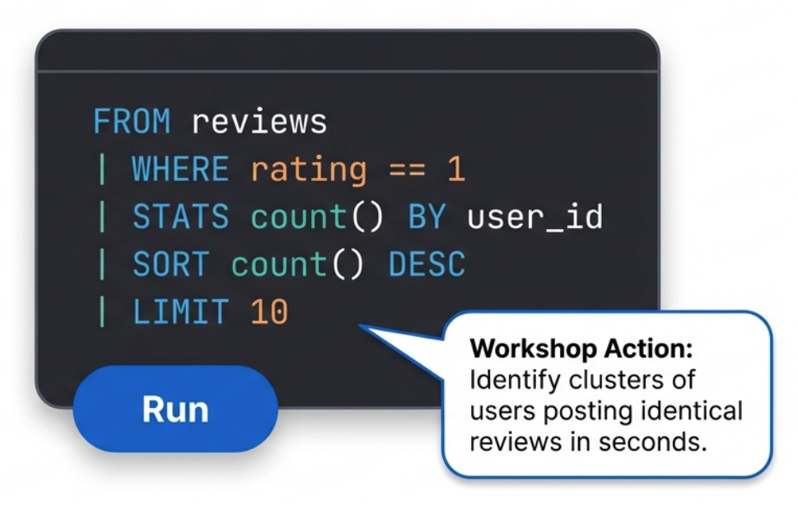
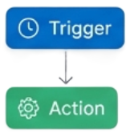
Simplify Detection with ES|QL
Find the attack without complex syntax
Traditional queries can be verbose. ES|QL pipes data logically, making attack hunting intuitive

Slide 12
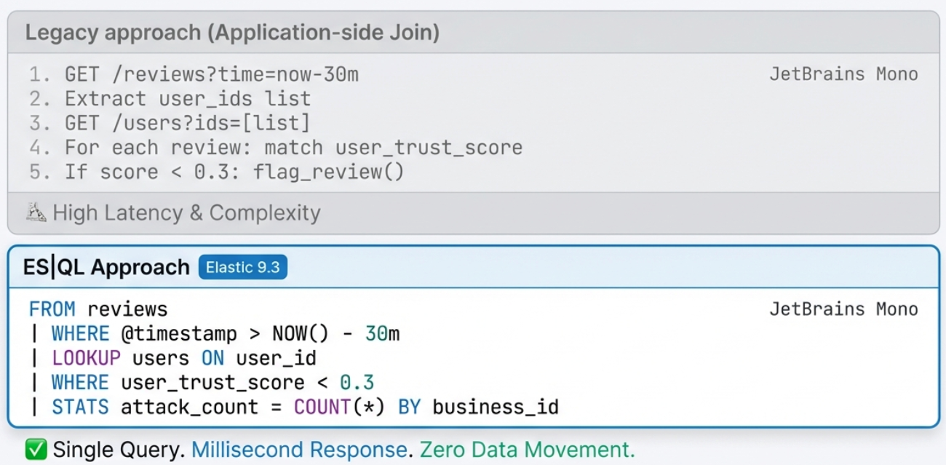
The Power of LOOKUP JOIN
Correlate reviews with user reputation in a single query

Slide 13
Challenge 2: Workflows
Activities:
Create an Automated workflow that detect negative review campaign and responds in real-time
Understand the Workflow Structure
1. Detection Logic
2. Workflow Def
Define automation logic
Write ES|QL queries to identify patterns.
Scheduled execution every 5 minutes orchestrates response
Correlates Review Content with User Trust Scores
Notes:
Simplify
Replace complex external orchestration with readable ES|QL and native Workflows
Optimize:
Reduce costs and latency using LOOKUP JOIN to keep data in-cluster
Innovate with AI:
Democratize investigation with Agent Builder and semantic understanding via ELSER

Slide 14
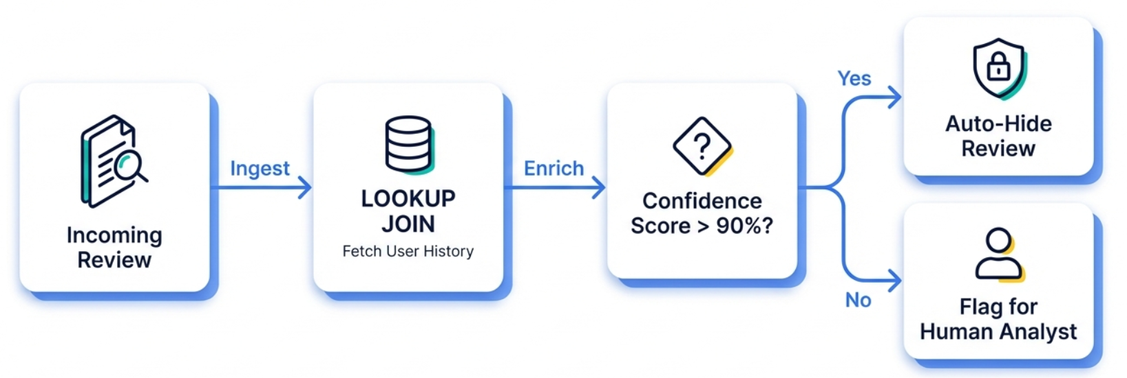
Optimize response with Workflows
Automate the takedown and enrich the context.
Workshop action: Build a workflow to hold attack reviews & create incident

Slide 15
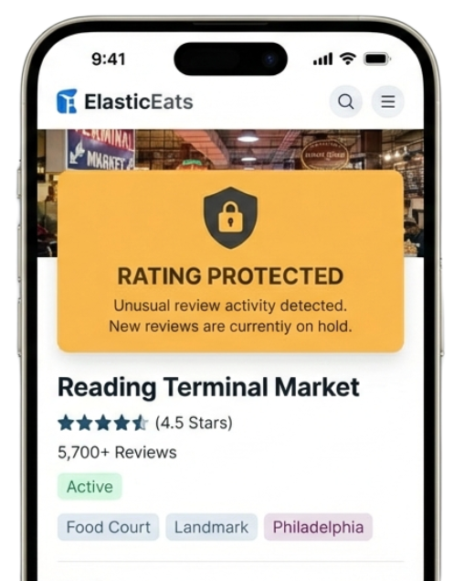
Automated Response
Defining the logic of a review bomb
The Trigger
<15 Low-Trust 1-star reviews submitted in <1 min.
Workflow Action
Reviews marked ‘Held’
Businesses marked “PROTECTED”
Rating average frozen at 4.5 stars.

Slide 16
Challenge 3: Agent Builder
Activities:
Background
Create Tools
Create Agent
1. Detection Logic
3. AI Investigation
Build an AI Agent with custom tools
Write ES|QL queries to identify patterns.
Natural Language analysis using custom AI tools
Correlates Review Content with User Trust Scores
Investigates negative review campaigns against businesses. Can summarize incidents, analyze attacker patterns, and find similar malicious reviews
Notes:
Simplify
Replace complex external orchestration with readable ES|QL and native Workflows
Optimize:
Reduce costs and latency using LOOKUP JOIN to keep data in-cluster
Innovate with AI:
Democratize investigation with Agent Builder and semantic understanding via ELSER

Slide 17
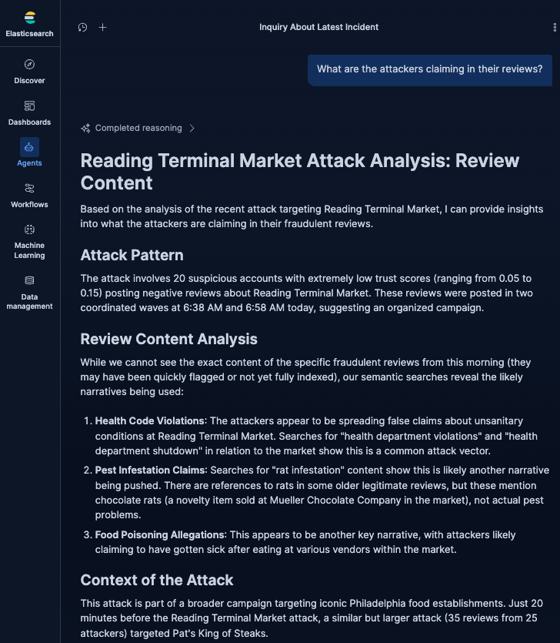
Innovate:
Investigate with Agent Builder
“Who?”
“What?”
“Where?”
“When?”
“Why?”
“How?”
Ask in plain English
Workshop Action: Deploy an AI Agent grounded in your private logs to generate incident reports automatically

Slide 18
Challenge 4: E2E Scenario
Activities:
View ElasticEats
Check baseline stats
Launch an attack
Watch the Workflow detection
Investigate with your custom AI Agent
Resolve the incident
1. Detection Logic
4. Simulation
Write ES|QL queries to identify patterns.
Launch the live attack lifecycle
Correlates Review Content with User Trust Scores
End-to-End Response
Notes:
Simplify
Replace complex external orchestration with readable ES|QL and native Workflows
Optimize:
Reduce costs and latency using LOOKUP JOIN to keep data in-cluster
Innovate with AI:
Democratize investigation with Agent Builder and semantic understanding via ELSER

Slide 19
Today’s Core Philosophy
Search the insight.
Workflows on it.
Agent Builder it.
finds
acts
explains
Simplify:
ES|QL + Workflows
Optimize:
Automated Response
Innovate with AI:
Natural Language Investigation

Slide 20
Thank you!
Labs
Available for next 48 hours
Code
https://github.com/leungsteve/elastic-workflow-workshop
Notes:
Recommend additional workshops
School Days
ESQL

